Slide 1


Project
Loan EMI & CIBIL Score Calculator
Presented By:​
Shivam Kumar(12207540)​
School of Computer Application​
Lovely Professional University, Phagwara​
​

Slide 2
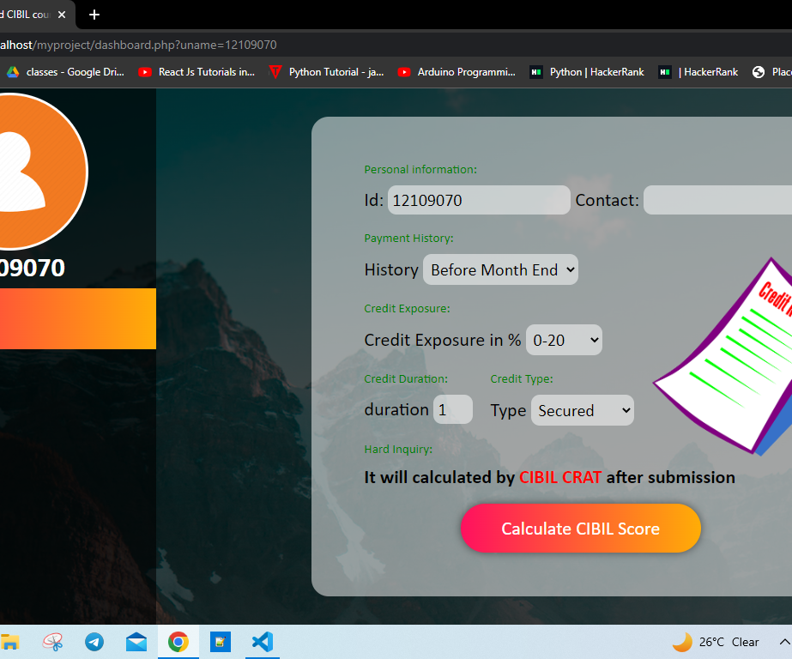
LOAN EMI AND CIBIL COUNT CALCULATOR
NIKITA KUMARI
12109070
ALLAUDDIN ALI
12113258

Slide 3
OVERVIEW
The CIBIL Score is a 3-digit numeric summary of your credit history. This number ranges from 300 to 900 and detailed information is given in Credit Information Report (CIR). This score tells lender or credit card company how likely you are to pay back the credit. It shows your past performance in credit usage and loan repayment behavior. Usually, 700 and more is considered a good score by lenders to provide loans. However, every lender has their own criteria to decide the eligibility for loan sanction and CIBIL does not define any yardstick to decide it.

Slide 4
OBJECTIVES
Users can register themselves , login , count the Cibil Score and check the eligibility for the loan.
Users will have their own profile with their User-ID.
User's profiles are password protected.
Users can give their feedback using Write To Us option.

Slide 5
Algorithm For Cibil Count
Past Performance/History:
The borrower’s past performance in handling debt obligations gets the highest weightage of 30% in preparing the CIBIL score.
Credit Exposure:
The borrower’s total credit exposure constitutes a 25% weightage in preparing the CIBIL report.
Credit Type and Duration:
The type of credit, such as secured and unsecured, and the duration of the credit, contribute 25% to CIBIL score calculation.
Other Factors/Hard Inquiry:
Factors such as credit utilization ratio and credit inquiry comprise the remaining 20% weightage to CIBIL score formula.

Slide 6
Requirement Specifications
Hardware Requirement:
Processor :Intel 3
Motherboard :Intel 915GVSR chipset
RAM :2GB DDR2 RAM
Hard Disk Drive :40GB
Software Requirement:
Visual Studio Code
WAMP Server
Skills Include:
Front End :HTML, CSS, JavaScript
Back End :PHP, MySQL

Slide 7
MODULES
User Registration/ Login
User details entry
View Details
Loan EMI
User credit score calculation

Slide 8
Activity Diagram
Log In
Dashboard
Cibil Score
Apply for Loan EMI
Write to us
Log Out
Register
USER

Slide 9
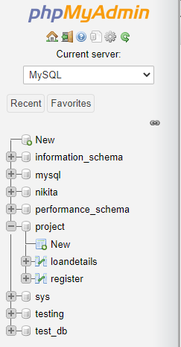


Database Design

Slide 10
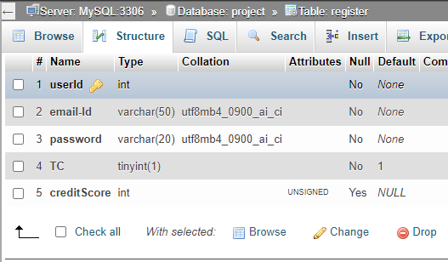
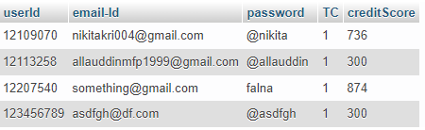
Database: project Table: register

Slide 11
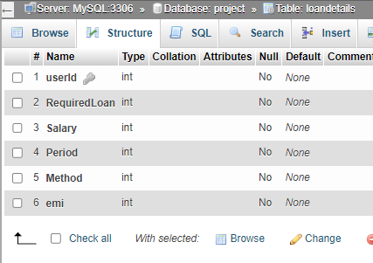
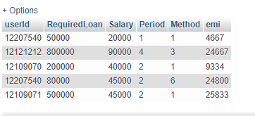
Database: project​ Table: loanDetails

Slide 12
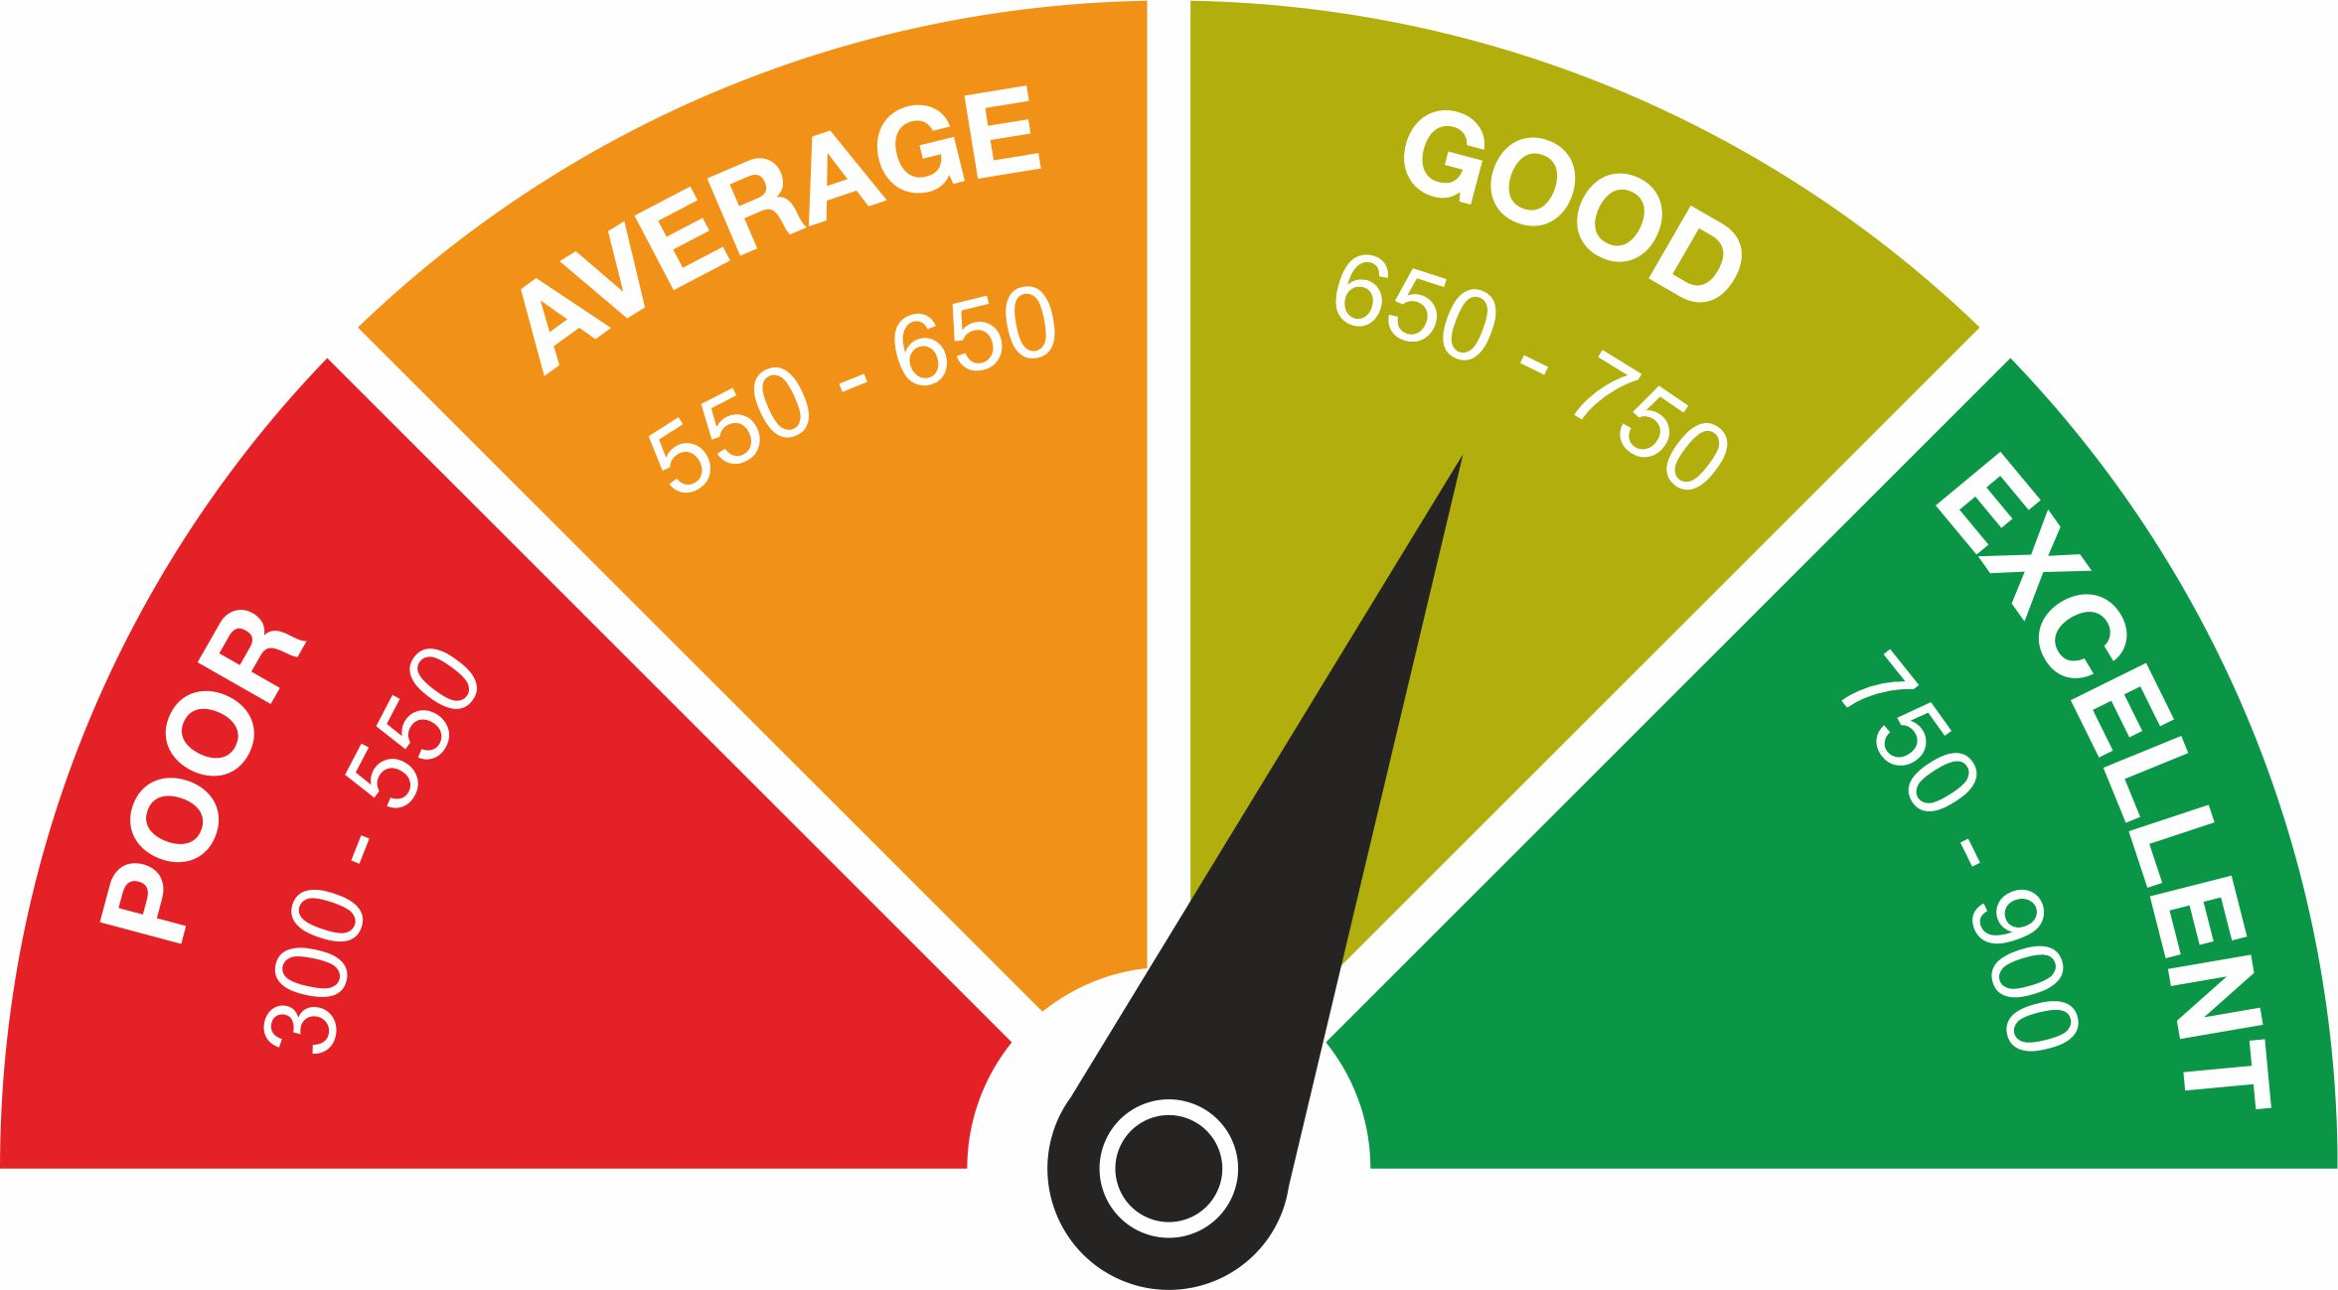
Demo Output Of This Project
CIBIL Score Range

Slide 13
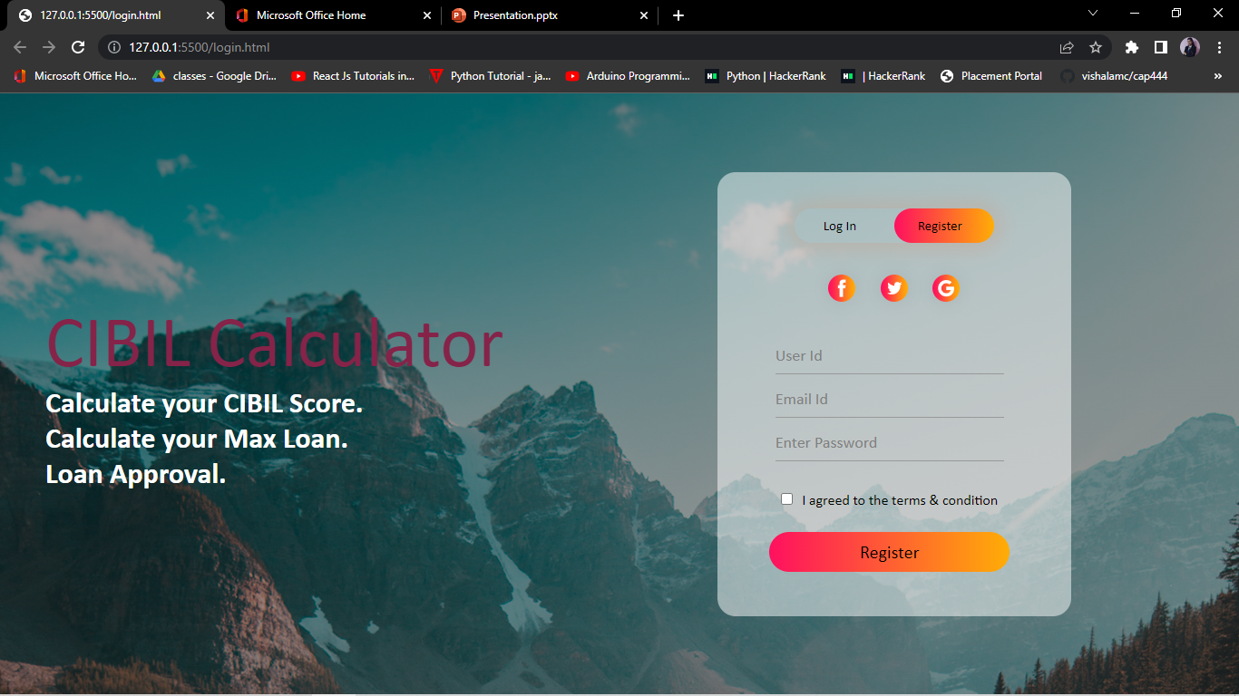
Register

Slide 14
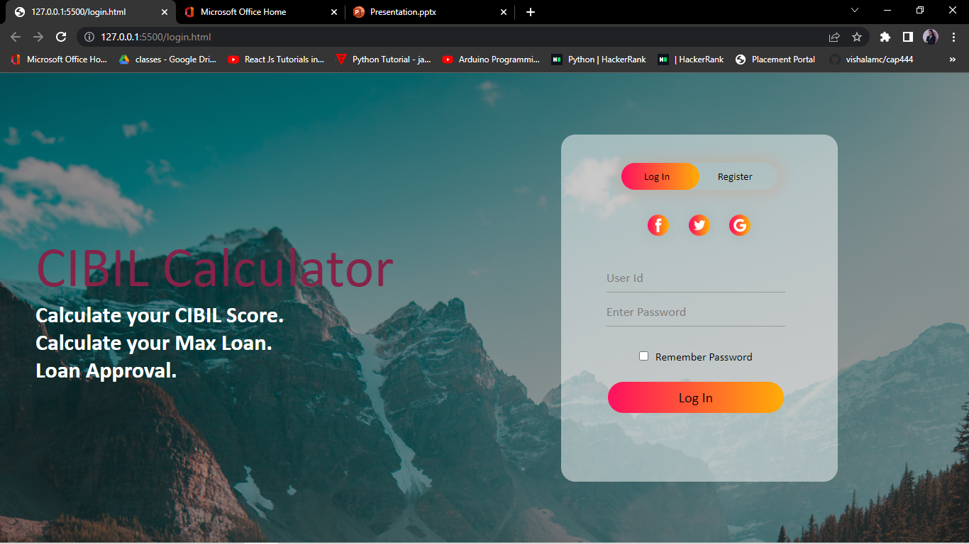
Log In

Slide 15
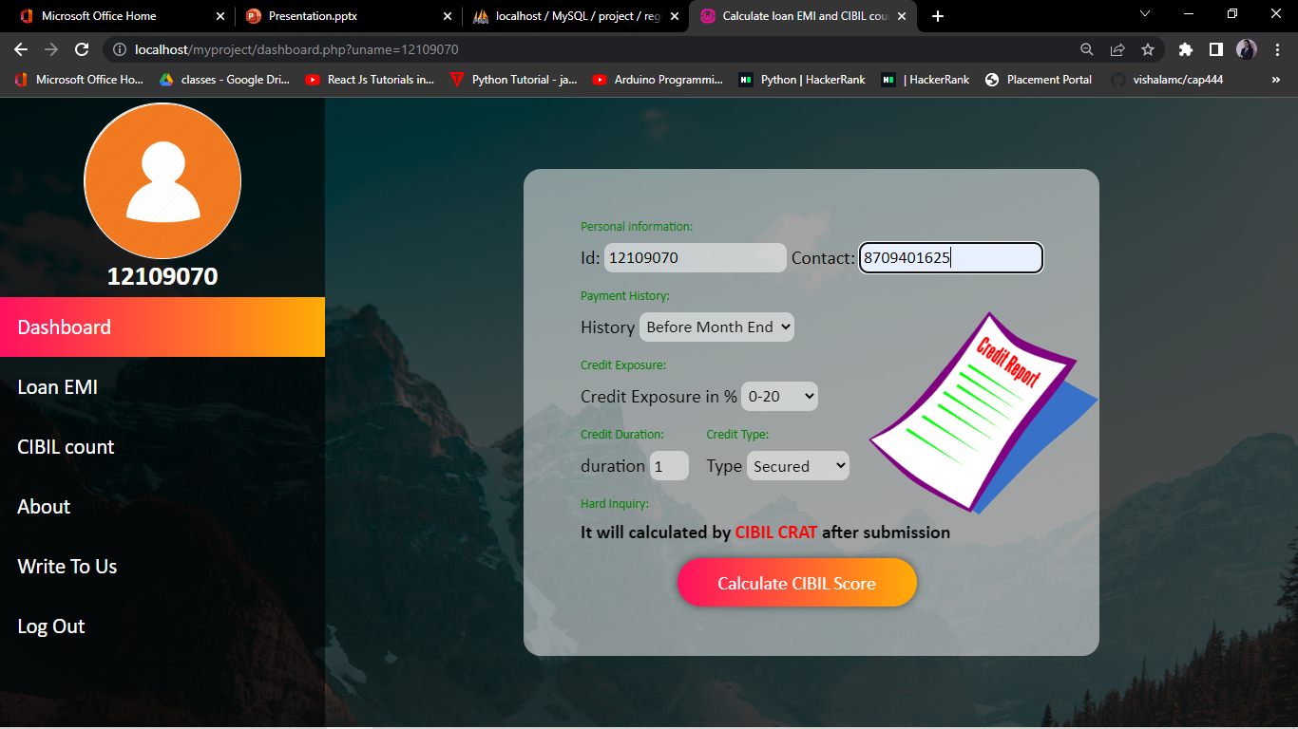
Dashboard

Slide 16
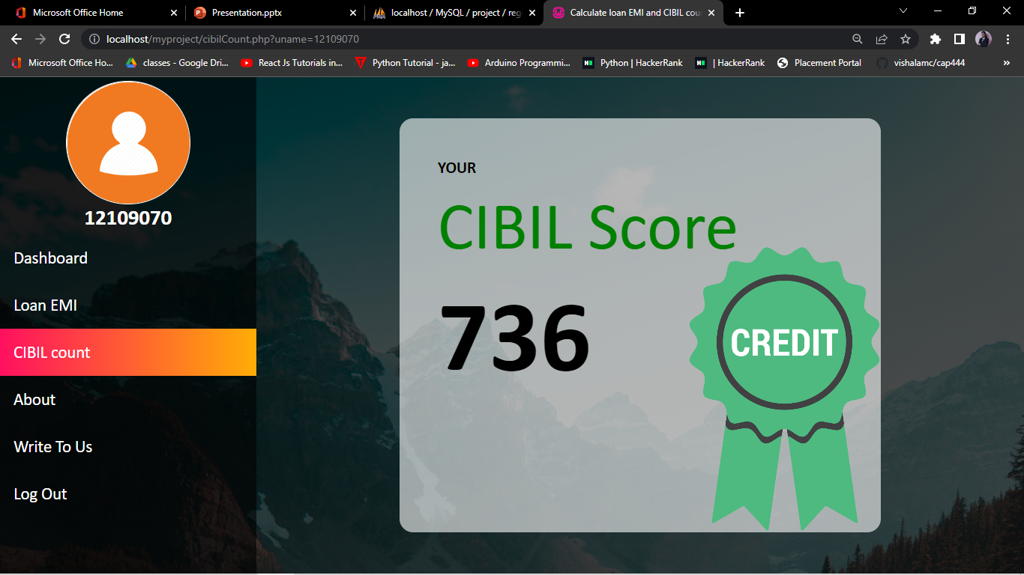
CIBIL Score

Slide 17
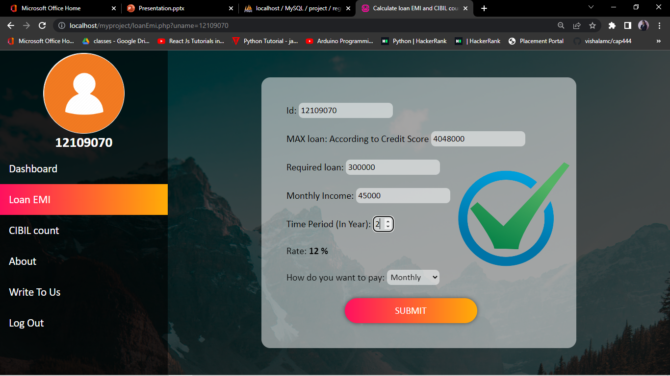
Loan EMI

Slide 18
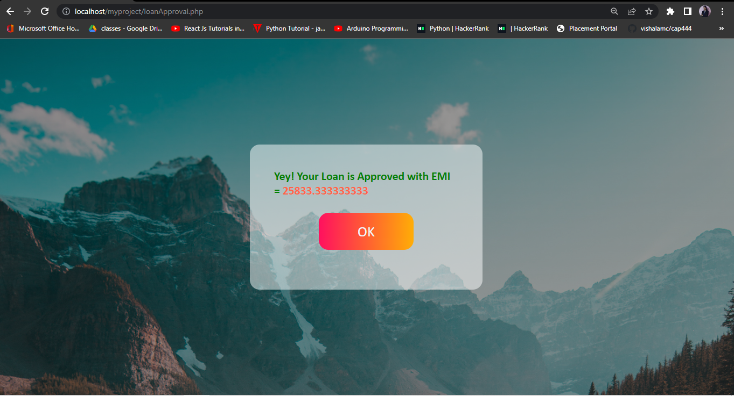
EMI Result

Slide 19
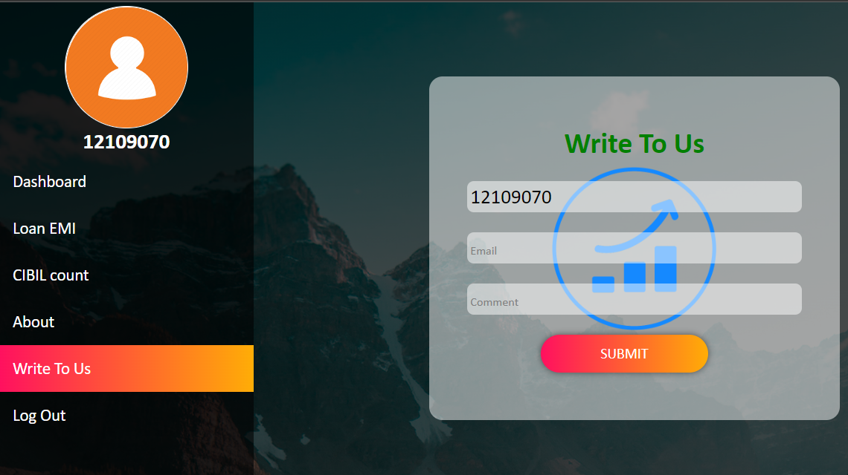
Write To Us

Slide 20
Bibliography or References
www.wikipedia.com
https://developer.mozilla.org/en-US/docs/Web/JavaScript
https://www.google.com/
w3schools.com/php/
https://www.php.net/docs.php https://dev.mysql.com/doc/

Slide 21
THANK YOU

